Slide 1
Computer Vision
Fall 2017
Problem Set #6
Sergiy Palguyev
sergiy.palguyev@gatech.edu
Computer Vision @ GT

Slide 2


1a: Average face
ps6-1-a-1.png
Computer Vision @ GT

Slide 3
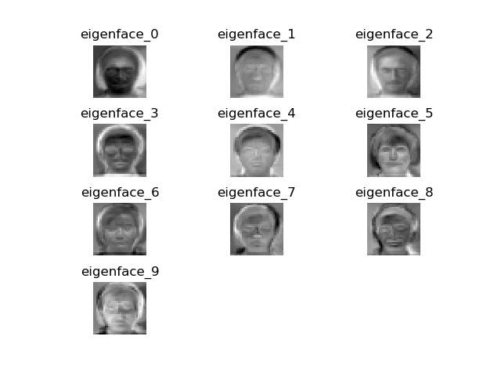
1b: Eigenvectors
ps6-1-b-1.png
Computer Vision @ GT

Slide 4
1c: Analysis
The predictions perform better than randomly selecting a label provided a good data set is given.
Lowering k value significantly decreases accuracy.
Increasing k value slight increases accuracy.
Lowering or Increasing p value to extremes will decrease accuracy in both cases.
Computer Vision @ GT

Slide 5
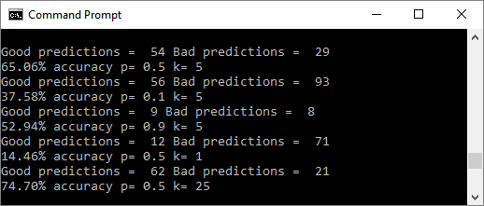
1c: Analysis
Example used for analysis:
Computer Vision @ GT

Slide 6
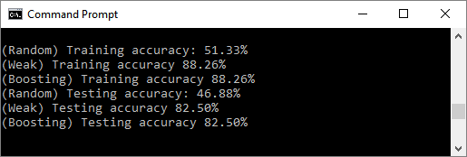
2a: Average accuracy
Approximately 88% for training and 82% for testing:
Computer Vision @ GT

Slide 7
2a: Analysis
Between Random, Weak, and Boosting, it appears there is not much difference between Weak and Boosting methods.
Slightly lowering p value, increases testing accuracy and slightly the training accuracy.
Dropping p value lower, increases training accuracy and slightly the testing accuracy.
Decreasing number of iterations slightly lowers accuracy for all.
Increasing number of iterations slightly increases accuracy for all.
Computer Vision @ GT

Slide 8
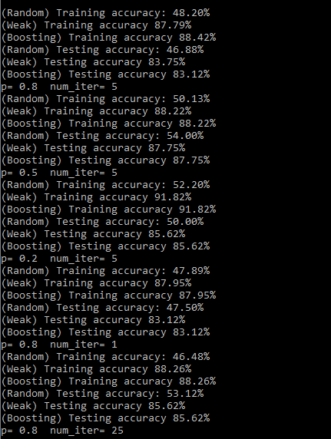
2a: Analysis
Example used for analysis:
Computer Vision @ GT

Slide 9

3a: Haar Features
ps6-3-a-1.png
Computer Vision @ GT

Slide 10

3a: Haar Features
ps6-3-a-2.png
Computer Vision @ GT

Slide 11

3a: Haar Features
ps6-3-a-3.png
Computer Vision @ GT

Slide 12

3a: Haar Features
ps6-3-a-4.png
Computer Vision @ GT

Slide 13

3a: Haar Features
ps6-3-a-5.png
Computer Vision @ GT

Slide 14
3c: Analysis
Using integral imaging helps by allowing estimations to be made in almost constant time irrelavant of image size, whereas a np.sum function would require quadratic compute time with the growth of image size.
Computer Vision @ GT

Slide 15
4b: Viola Jones Features
ps6-4-b-1.png
Computer Vision @ GT

Slide 16
4b: Viola Jones Features
ps6-4-b-2.png
Computer Vision @ GT

Slide 17
4b: Analysis
Add more slides if needed.
Computer Vision @ GT

Slide 18
4c: Viola Jones Face Recognition
ps6-4-c-1.png
Computer Vision @ GT

